Slide 1
Course Materials May Not Be Distributed or Posted Electronically
These course materials are the sole property of Dr. Todd M. Gross. They are strictly for use by students enrolled in a course taught by Dr. Gross. They may not be altered, excerpted, distributed, or posted to any website or other document-sharing service without express permission.

Slide 2
PSTAT 126 Regression Analysis
Dr. Todd Gross
Department of Statistics and Applied Probability
UCSB

Slide 3
Lecture 6 Diagnostics and Remedial Measures

Slide 4
Lecture Outline
Major assumptions of the normal error regression model
Diagnosing possible violations
Remedial Measures

Slide 5
“All models are wrong, some are useful.”
“Statisticians, like artists, have the bad habit of falling in love with their models.”
George Box

Slide 6
The Importance of Model Accuracy
I need to fertilize my lawn. How much fertilizer do I need?
My estimate is only as accurate as the model I use to calculate the area
If I choose the wrong model, I will get an inaccurate estimate
Area = height X width – .25(h*w)

Slide 7
The Need for Assumptions
In order for the linear model to provide valid estimates, its assumptions must hold true
If the assumptions are violated, then the estimates of regression coefficients, and/or the corresponding confidence intervals and p-values, may be distorted.
We must diagnose possible violations (i.e., deviations) from the model before we accept the results of fitting and testing the model
We may be able to correct, or remediate, violations to produce a valid regression model

Slide 8
Major Assumptions of the Normal Error Regression Model
The normal error regression model is:
This equation implies the following assumptions:
Linearity – Y is a linear function of X
Independence – the responses (and their errors) are independent of each other
Identically Distributed – all observations come from the same population
Normality – the responses follow a Normal distribution
Constant Variance – σ² is the same for all values of X

Slide 9
Linearity
Linear regression is valid when there is a linear relationship between X and Y
If the relationship between X and Y is non-linear, then the linear model cannot accurately describe the shape and strength of the relationship
Y is a linear function of X

Slide 10
Independence
iid stands for Independent and Identically Distributed
This first part of this assumption (Independence) means that each observation is independent of every other observation
If the observations are related somehow, the resulting regression model may be distorted
Errors are Independent and Identically Distributed

Slide 11
Identically Distributed
iid stands for Independent and Identically Distributed
This second part of this assumption (Identically Distributed) means that all of the observations come from the same population
An outlier, or extreme observation, may be from a different population
Errors are Independent and Identically Distributed

Slide 12
Normality
Y values, and their corresponding errors, are normally distributed
If Y values are not normally distributed (e.g., skewed) then the sampling distribution of b₁ will be incorrect
Errors are Normally Distributed

Slide 13
Constant Variance
Variance of the Y values, and their corresponding errors, is constant across all values of X
If variance is not constant (i.e., variance is smaller at low values of X and higher at high values of X), then the standard error of b₁ will be incorrect
Variance is constant
across range of X values

Slide 14
Diagnosing the Fit of the Linear Regression Model
Possible Violations of Assumptions
Non-linear relationship
Non-constant variance
Non-normal distribution of errors
Non-Independence of responses (or errors)
Not Identically Distributed (no outliers)
Additional Problems to Consider
Truncated or Restricted Range
Important Predictor Omitted from the Model
We will use graphic techniques (i.e., data displays) to identify potential violations
If we observe possible violations, we can apply remedial methods to correct them

Slide 15
Residuals Analysis
It is often more useful to look at the residuals (Y-Y’) to identify model violations
Several of the assumptions deal directly with the residuals
Deviations from the model may be more readily seen by “removing” the linear function first
Calculation of the residuals stays the same even when we move to more complex models with multiple predictors
We will supplement inspecting the residuals with other data exploration techniques

Slide 16
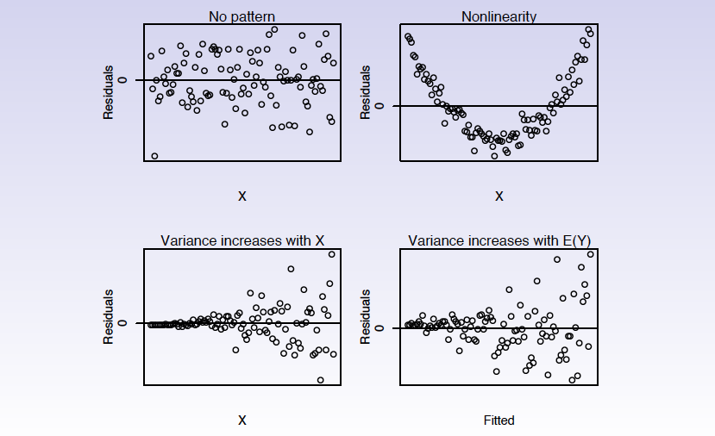
Prototypes of Residuals Plots

Slide 17
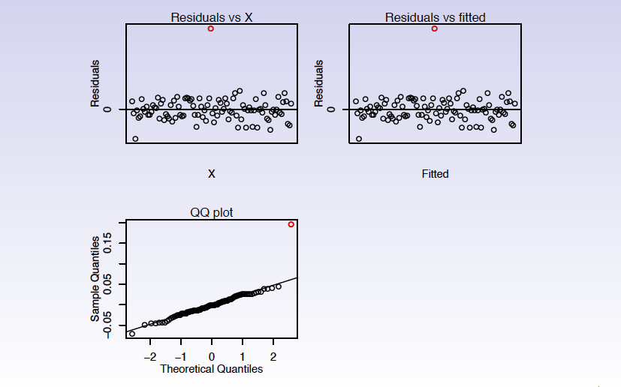
Outlier

Slide 18
Steps for Evaluating Violations
Generate the desired plot
Compare to ideal case with no violation
Identify and apply remedial method
Redo plot to confirm that remediation is adequate

Slide 19
Linearity versus Non-linear
Compare the two scatterplots below.
Linear Relationship
Non-linear Relationship

Slide 20
Linearity versus Non-linear
The regression line makes both appear fairly linear
Linear Relationship
Non-linear Relationship

Slide 21
Non-linear Residuals Plot
The residuals plot reveals a strong non-linear component
Scatterplot
Residuals Plot
R² = 83%

Slide 22
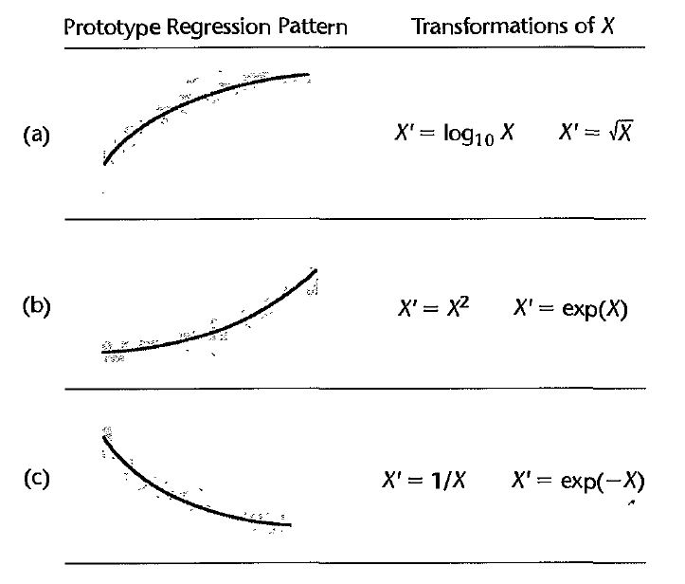
Non-Linear Remediation
If the relationship between X and Y appears to be non-linear:
Transform X
Perform non-linear regression (will be covered in later lecture)

Slide 23
Transforming X
Create new X variable: X = log₁₀(X)
This will reduce non-linearity, but may not eliminate it
Scatterplot
Residuals Plot
R² = 96%

Slide 24
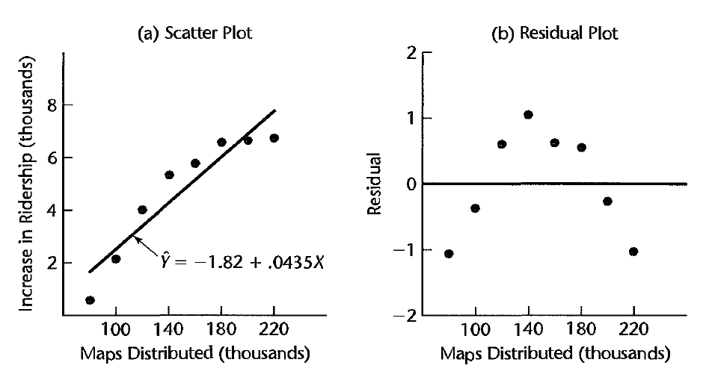
Summary for Non-linearity
The linear regression model describes a linear relationship between X and Y
If there is a non-linear relationship, then the linear model will underestimate the strength of the X-Y relationship
Diagnosis – Plot residuals against X values (or against predicted Y values, same thing)
Remediation – Transform X, or perform Non-Linear Regression

Slide 25
Constant versus Non-constant Variance
Constant Variance
Non-Constant Variance

Slide 26
Non-constant Variance
Is variance constant across the range of Y?
Note that variance may “bulge” or “trumpet”
Scatterplot
Residuals Plot

Slide 27
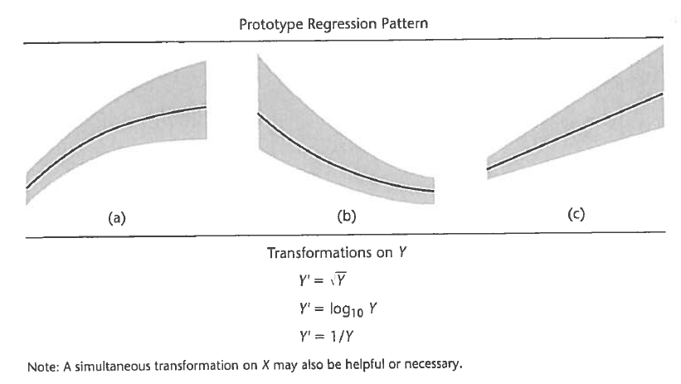
Transformation of Y
If the variance of Y is not constant (unequal across X), or non-normal, consider transforming Y

Slide 28
Transforming Y
Create new Y variable: Y = log₁₀(Y)
This may reduce non-constant variance, but may not eliminate it
Scatterplot
Residuals Plot

Slide 29
Non-constant Variance Summary
The regression model assumes that each observation of Y has the same Population variance
Violation can reduce the fit of the model, and inflate CI’s and p-values
Diagnosis – Residual plot will show variance spreading out over values of X
Remediation – Attempt to transform Y to make variance more consistent

Slide 30
Non-normal distribution of errors
Hypothesis tests and confidence intervals assume a normal distribution of error terms (ε_{i})
Violation of normality can invalidate p-values and confidence intervals.
In practice, sufficiently large sample size addresses this assumption.
Diagnosis – Use QQ plot to compare observed distribution of errors to Normal distribution.
Remediation – Depends on nature of deviation from normality. Increase sample size or possibly transform Y to reduce skew.

Slide 31
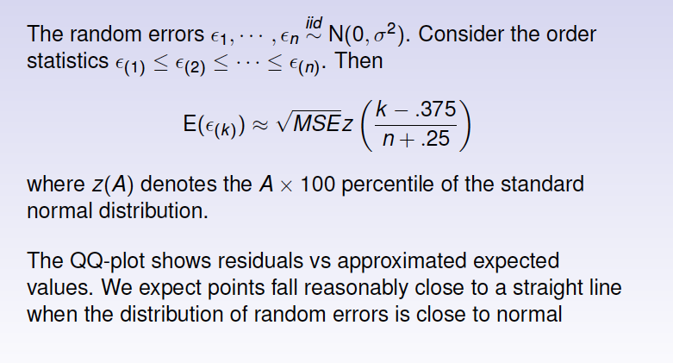
QQ-plot (Normal Probability Plot)

Slide 32
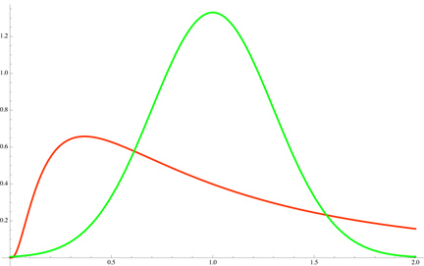
QQ Normal Plots
QQ stands for Quantile-Quantile
Compares the observed distribution to a normal distribution
Created by:
ordering residuals from low to high
calculating a standardized score (like a z-score) for each value in the sample
plotting theobserved standard score against the z-score expected for the i^{th}/n score in a normal distribution
Normal (theoretical) distribution
Observed distribution
Position of the i^{th} score in the Normal distribution (larger standard score)
Position of the i^{th} score in the sample
(smaller standard score)

Slide 33
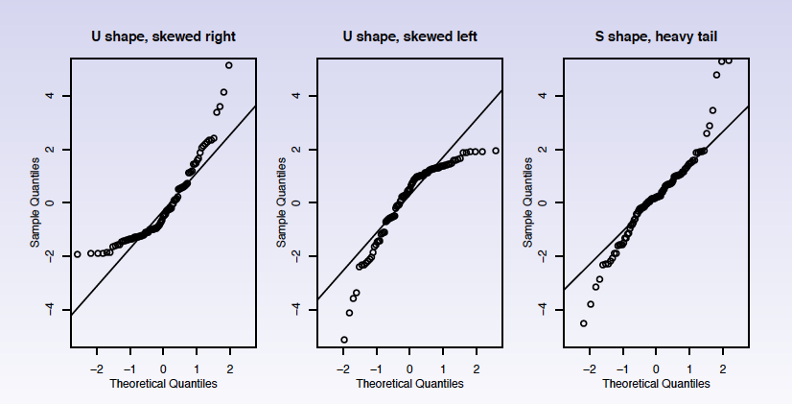
QQ-Plots of Non-Normal Residuals

Slide 34
Impact of Transforming Variables
If we transform X or Y (or both) to address a violation, the estimates of the coefficients will be transformed as well
This will change interpretation of the slope
Example:
X transformed: Slope = Unit Change in Y per Log Unit Change in X
Y transformed: Slope = Square Root of Unit Change in Y per Unit Change in X
Standard practice:
Fit the model using transformed variables
Base p-values on transformed model
Disclose transformation when reporting analysis
Convert estimates (slope, intercept, confidence intervals) back to original units (reverse the transformation) when reporting model

Slide 35
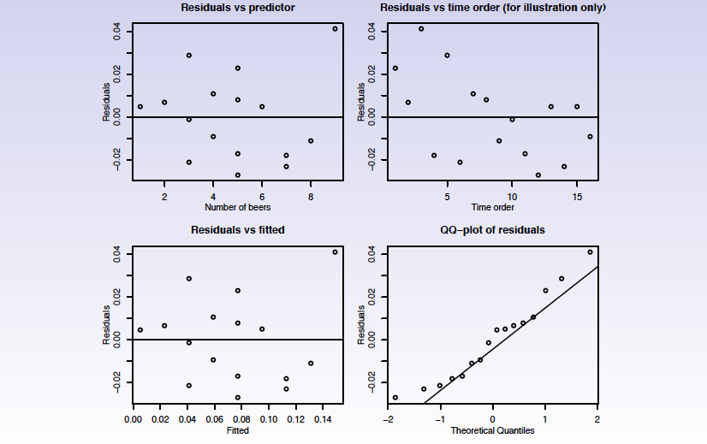
Dependent Errors
The least squares estimators assume that observations (and their individual error terms) are independent of one another
Violation may effect estimates and p-values
Diagnosis – plot residuals as a function of variable(s) that may introduce dependency (time, season, geography or sequence of data collection)
Remediation – Use model for correlated error terms (not covered in this course)

Slide 36
Outliers
An observation that deviates from the X-Y relationship can distort the value of slope and intercept, and reduce the fit of the regression equation (R² and hypothesis tests)
Diagnosis – Plot residuals against X values (or against predicted Y values, same thing)
Remediation – Remove outlier if it is due to error in data collection, or observation that is not representative of population under study (unique characteristics)

Slide 37
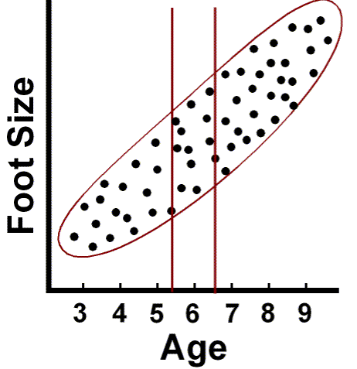
Truncated Range
The values of X must have an adequate range in order for the regression model to work
Diagnosis – Compare range of X to known range of interest
Remediation – Collect data with expanded range of X

Slide 38
Important Predictor Omitted from Model
Predictor variable that is NOT in the model may influence appearance of linear relationship.
Variable may mask an existing relationship, or artificially induce a relationship
Diagnosis – Generate separate residual plots for each value of the omitted variable
Remediate – Analyze separate linear model for each subgroup

Slide 39
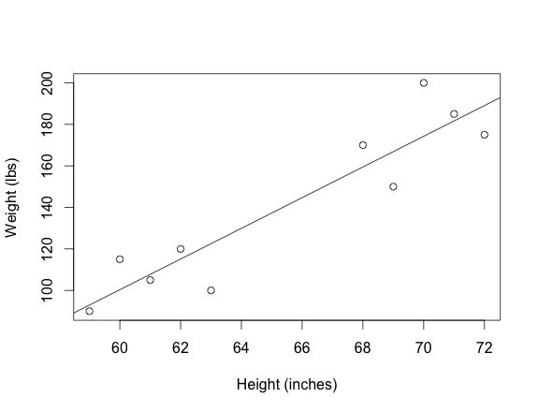
Example of Omitted Predictor
Do these data demonstrate a linear relationship between Height and Weight?
Yes - apparently

Slide 40
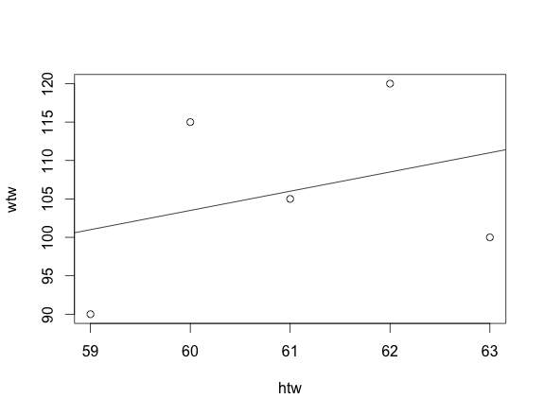
Example of Omitted Predictor Inducing a Linear Relationship
But what if we separate the data into Men and Women?
The relationship between Height and Weight is WEAK within each subgroup
Men
Women

Slide 41
Omitted Predictor Can Mask a Relationship Also
There is a strong linear relationship between X and Y within each subgroup
But if we omit the grouping variable, the overall linear regression will look weak, or even reverse direction
Psychology Test
Calculus Test
Exam Score
Hours of Study

Slide 42
Summary of Violations, Plots and Remediation
Violation | Diagnostic Plot | Remidiation
Non-linear | Residuals | Transform X
Non-constant variance | Residuals | Transform Y
Non-normal | QQ Plot, then histogram | Transform Y (to remove skew)
Non-independence | Residuals plot (against index) | Redo data collection, or remove dependent observations
Not Identically Distributed - Outliers | Scatterplot/Residuals plot | Remove outlier
Truncated range | Histogram | Redo data collection
Predictor omitted from model | Residuals plotted against third variance | Add predictor to model (multiple regression)

Slide 43
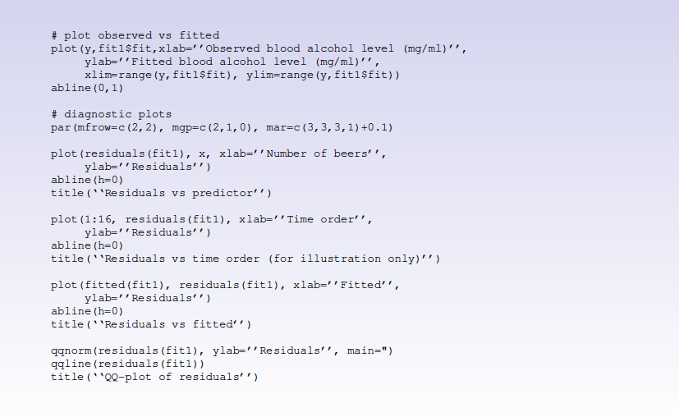
Diagnostic Plots in R

Slide 44
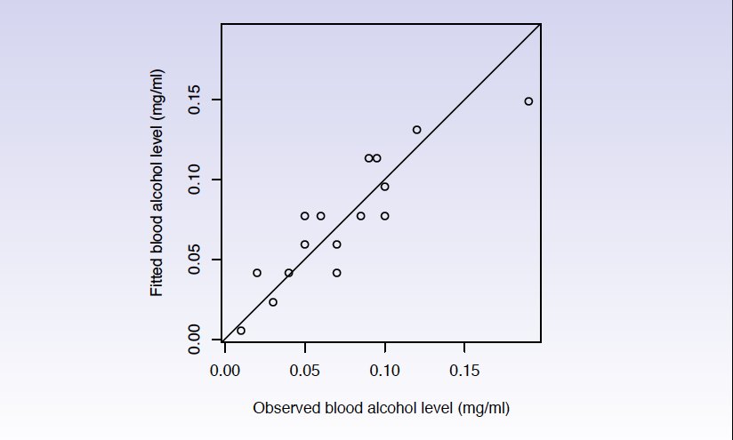
Observed vs. Fitted for Beer Data

Slide 45
Diagnostic Plots for Beer Data

